Slide 1

Project Title - Seasonal Agriculture Performance Analysis
Student Name- Navyashree Avadhani
College Name- RNS Institute Of Technology
AICTE STU ID : STU6a6a1797ac22e1785337751

Slide 2

PROBLEM STATEMENT
Agricultural activities are influenced by seasonal variations in environmental conditions, farming practices, resource availability and market conditions. As a result, agricultural performance may differ from one season to another. However, raw agricultural data does not clearly explain how agricultural performance changes across seasons or what patterns can be observed in different seasonal conditions. The problem is to analyze the given agricultural dataset and investigate seasonal differences in agricultural performance by identifying meaningful patterns, trends, relationships and variations within the available data.

Slide 3
Project Description
This project analyzes agricultural performance across Kharif, Rabi and Zaid seasons using a dataset of 4,000 farm-level observations. The analysis examines crop yield, production, profitability, resource utilization, environmental conditions, irrigation practices and disease/pest risk to identify meaningful seasonal patterns.
The data was cleaned by handling missing values using season-based median imputation for environmental variables and production-area relationships for missing yield values. Descriptive statistics, group-wise comparisons, correlation analysis and ANOVA were applied to evaluate seasonal differences and relationships.
The study further compares crop-season combinations, state-season performance and irrigation methods to identify variations across regions and farming practices. The results indicate that while environmental conditions vary considerably across seasons, season alone does not produce a statistically significant difference in yield. However, profitability differs significantly across seasons, with Kharif showing the strongest overall performance and Zaid showing the weakest profitability.
The project converts raw agricultural data into practical insights that can support better seasonal crop planning, resource allocation and profitability-focused decision-making.

Slide 4

WHO ARE THE END USERS?
Farmers — seasonal crop and resource planning
Agricultural planners — regional and seasonal strategy
Agribusinesses — profitability and crop planning
Government agricultural departments — policy and resource allocation
Agricultural consultants — data-driven recommendations

Slide 5

Technology Used
Python
Google Colab
Pandas — Data cleaning & analysis
NumPy — Numerical operations
Matplotlib — Visualization
Seaborn — Statistical visualization
SciPy — ANOVA statistical testing

Slide 6
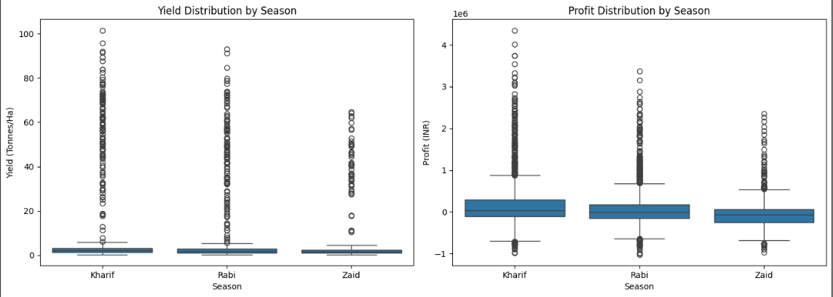
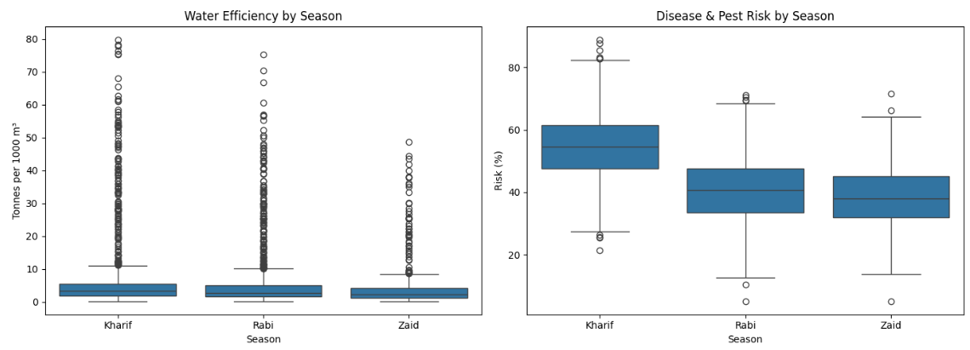
RESULTS
Kharif recorded the highest average yield (5.63 t/ha).
Kharif generated the highest average profit (₹1.79 lakh).
Zaid recorded the lowest average yield (4.63 t/ha) and an average loss of ₹0.25 lakh.
Kharif also had the highest average water efficiency (5.89 t/1,000 m³).
Takeaway:
Kharif shows the strongest overall seasonal performance, while Zaid requires greater profitability scrutiny.

Slide 7
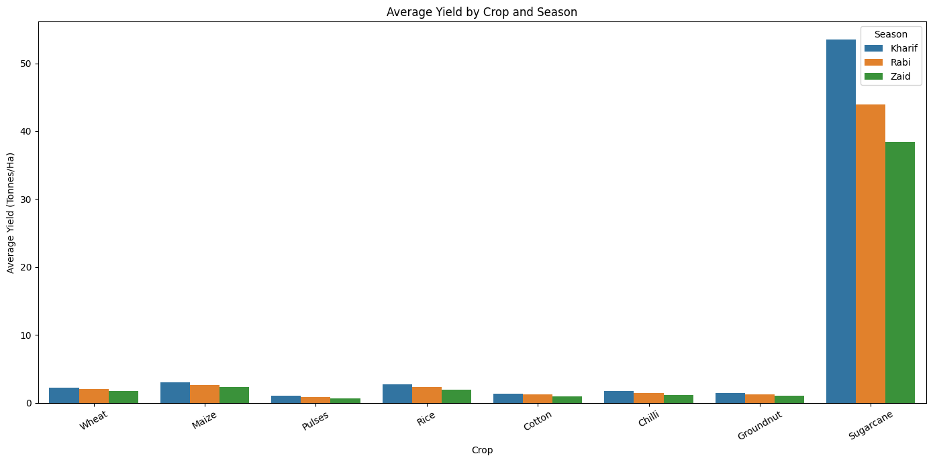
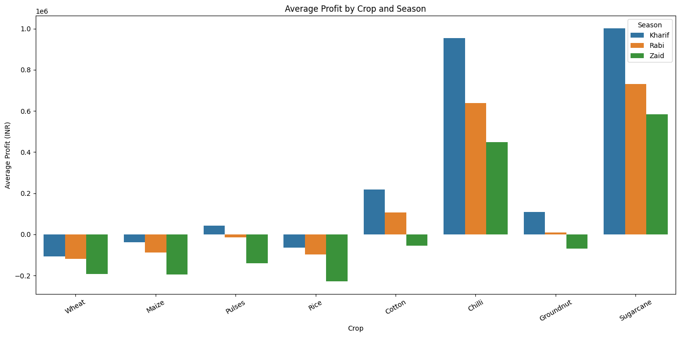
RESULTS
Sugarcane recorded exceptionally high yield compared with all other crops.
Sugarcane averaged 46.94 tonnes/ha across the dataset.
Maize, Rice and Wheat showed substantially lower average yields.
Crop performance also varied across seasons.
Profitability differed considerably between crop-season combinations.
Takeaway:
Crop choice has a major influence on observed agricultural performance, making crop-season combinations important for planning.

Slide 8
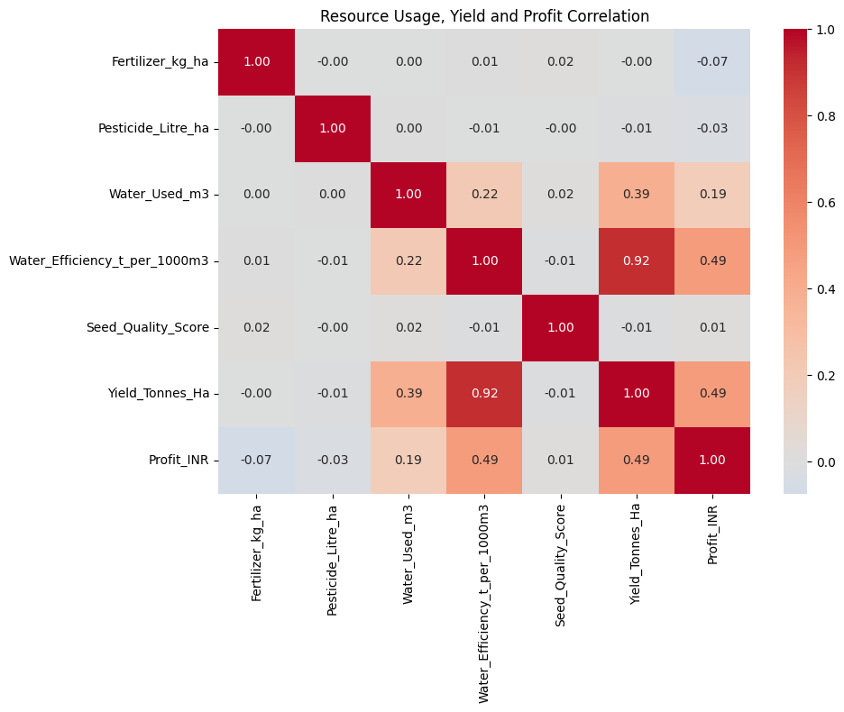
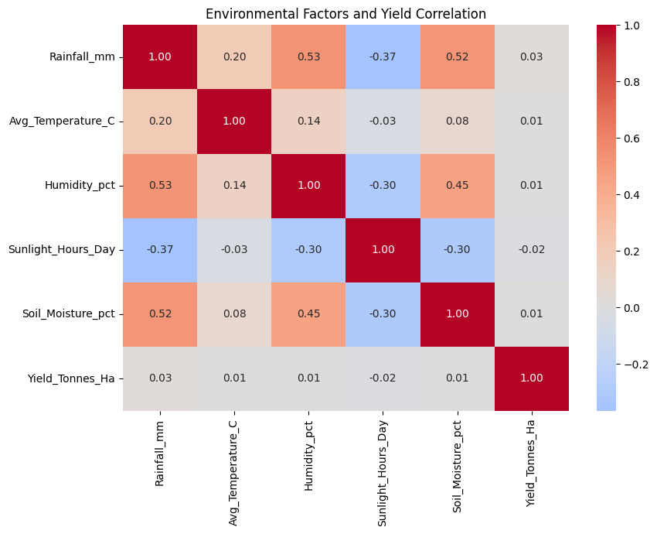
RESULTS
Takeaway:
Environmental conditions vary across seasons, but their individual linear relationships with yield are weak. Resource-use patterns provide additional insight into agricultural performance.
Environmental findings:
Rainfall–Yield correlation: 0.027
Temperature–Yield: 0.009
Humidity–Yield: 0.011
Soil Moisture–Yield: 0.010
Sunlight–Yield: −0.016

Slide 9
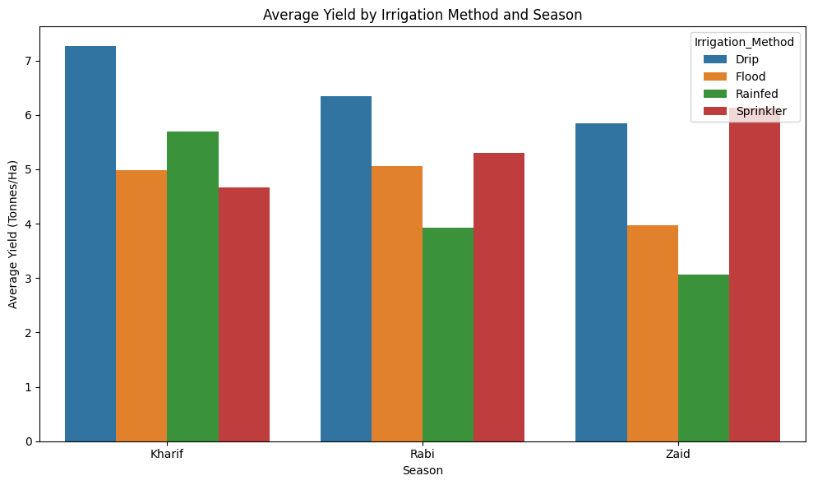
RESULTS
Kharif
Drip: 7.26 t/ha
Rainfed: 5.70 t/ha
Flood: 4.98 t/ha
Sprinkler: 4.67 t/ha
Rabi
Drip: 6.35 t/ha
Sprinkler: 5.30 t/ha
Flood: 5.06 t/ha
Rainfed: 3.93 t/ha
Zaid
Sprinkler: 6.13 t/ha
Drip: 5.85 t/ha
Flood: 3.97 t/ha
Rainfed: 3.06 t/ha
Bullets:
Drip irrigation recorded the highest yield among methods in Kharif and Rabi.
Sprinkler recorded the highest yield in Zaid.
Flood irrigation showed relatively high water consumption.
Irrigation performance varies by season.
Takeaway:
Efficient irrigation methods can support stronger performance, but the most effective method varies by season.

Slide 10
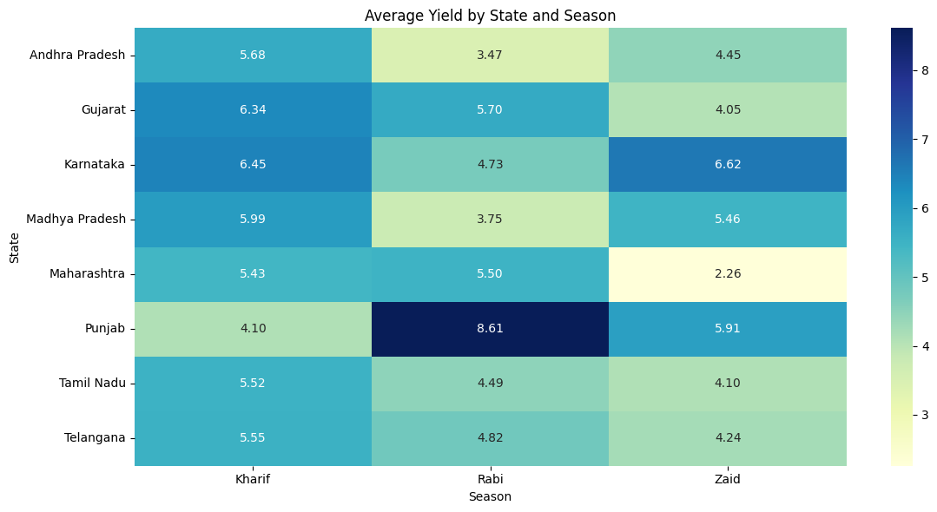
RESULTS
Key findings:
Punjab – Rabi: 8.61 t/ha → highest state-season yield.
Karnataka – Zaid: 6.62 t/ha → strong Zaid performance.
Maharashtra – Zaid: 2.26 t/ha → lowest state-season yield.
Seasonal performance varies substantially between states.
No single season is consistently the best across all states.
Yield ANOVA
F = 1.4629
p = 0.2317
Not significant
Profit ANOVA
F = 34.2918
p < 0.001
Significant
Final takeaway:
Regional context matters: seasonal performance differs across states, while statistical testing shows that season has a significant effect on profitability but not on yield.

Slide 11
Future scope
Predictive Analysis: Develop models to forecast crop yield and profitability for different seasons.
Real-Time Data Integration: Incorporate live weather, soil and market-price data for dynamic decision-making.
Advanced Regional Analysis: Extend the study to more districts and regions to improve location-specific recommendations.
Crop Recommendation: Build a recommendation system that suggests suitable crop-season combinations based on environmental and economic conditions.
Interactive Dashboard: Develop an interactive dashboard to monitor seasonal performance, resource efficiency and profitability.
Future development can transform the analysis from descriptive insights into predictive and decision-support tools.

Slide 12
GitHub Link
https://github.com/Navya-avadhani/seasonal-agriculture-performance-analysis

Slide 13

VOIS Course completion certificate - Course name- Data Visualization

Slide 14
Thank you
.
.

